Slide 1
Evaluation of Parameters That Can Be Used As Auxiliary Test for the Diagnosis of Multiple Sclerosis
Stj. Dr. Yusuf Mert Gezer
Prof. Dr. Azize Esra Başar Gürsoy

Slide 2
PLAN
Multiple Sclerosis
Diagnosis of MS
Aim of Research
Material and Method
Results
Conclusion
References

Slide 3
Multiple Sclerosis
Multiple Sclerosis (MS); is a chronic inflammatory, demyelinating neurodegenerative disease of the central nervous system and is a leading cause of disability in young adults and causes significant socioeconomic losses.
The immune system plays an important role in the development of the disease, but the specific formation mechanism is still unknown.
Diagnosing the disease, monitor its activity, and staging it is difficult because MS shows a heterogeneous process that causes symptoms at different times and in different orders for each individual.

Slide 4
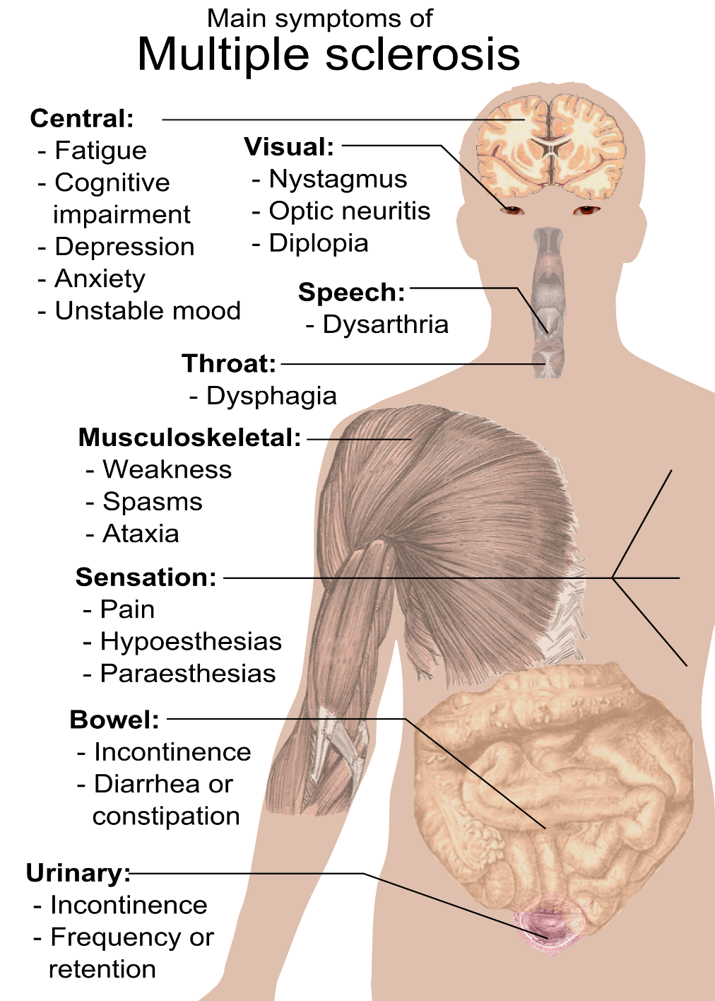
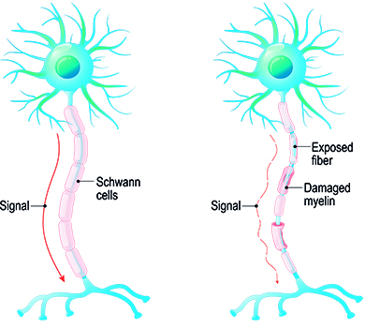
https://stiwell.medel.com/neurology/multiple-sclerosis
Häggström, Mikael (2014). "Medical gallery of Mikael Häggström 2014".

Slide 5
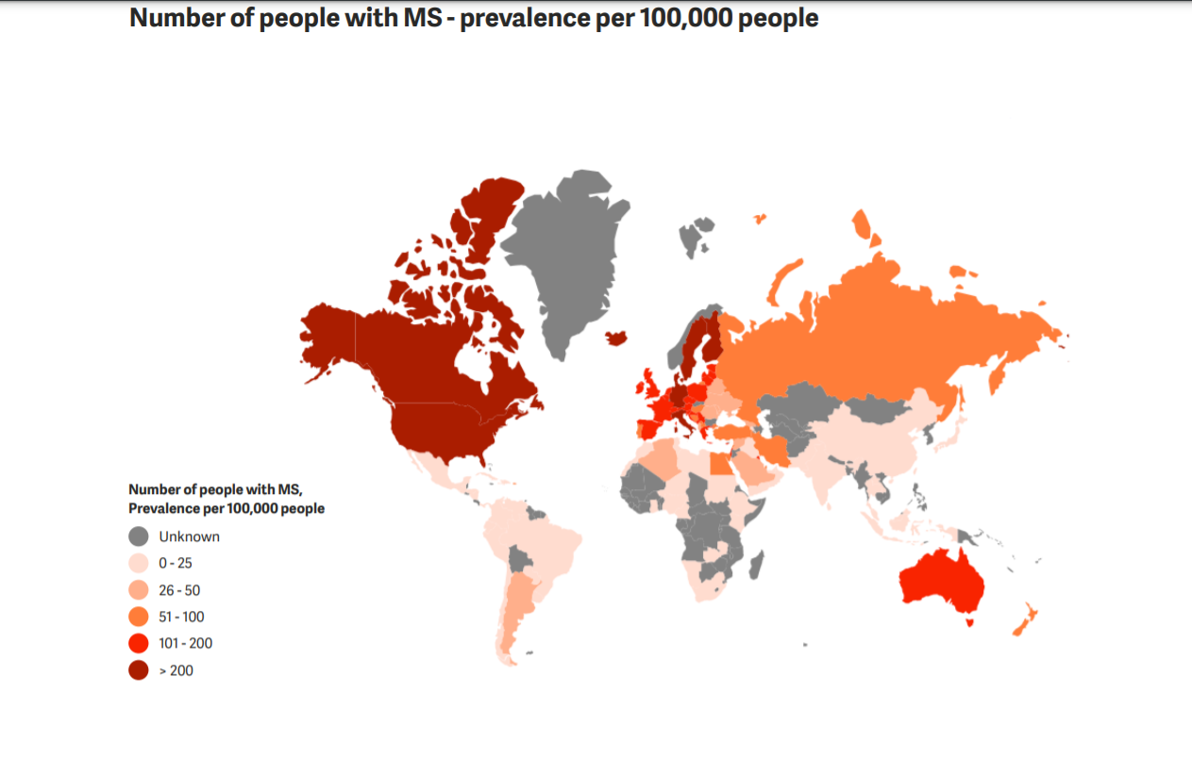
The MS prevalence in Turkey is similar to that of Greece and Bulgaria but lower than that of European countries.
Yahya Çelik et al. (3) showed that the MS prevalence in Edirne is similar to that of Greece and Bulgaria but lower than that of European countries. The prevalence rate of confirmed MS patients was 33.9/100000 (95% CI: 32-36) in 2003. The mean annual incidence was 3.48/100000 (95% CI: 2.90-4.00).
The Multiple Sclerosis International Federation, Atlas of MS, 3rd Edition (September 2020).

Slide 6
Diagnosis of MS
Diagnostic criteria for multiple sclerosis combining clinical, imaging, and laboratory evidence have evolved over time, with the most recent being the 2017 McDonald criteria from the International Panel on Diagnosis of Multiple Sclerosis.
MRI is usually sufficient to confirm the diagnosis when characteristic lesions are present and accompanied by a typical clinical syndrome. However, in some patients, cerebrospinal fluid (CSF) analyzes and neurophysiological tests can be used as supportive tests. In addition, it is important to distinguish from other demyelinating diseases, non-demyelinating diseases, and inflammatory, granulomatous, metabolic, and genetic causes that can mimic multiple sclerosis.
“Diagnosis of Multiple Sclerosis: 2017 Revisions of the McDonald Criteria.” The Lancet Neurology (2018)

Slide 7
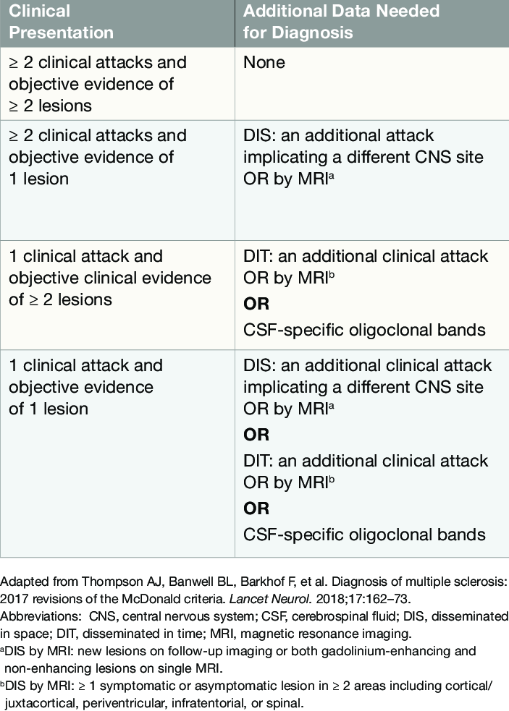
Advances in MRI, serological and genetic tests have greatly increased accuracy in the diagnosis and staging of Multiple Sclerosis but misdiagnosis still can be made. Therefore, one of the most critical needs regarding the disease is to find an objective and applicable test.
Bradshaw, Michael & Houtchens, Maria. (2018). Neurology Board Review: Multiple Sclerosis

Slide 8
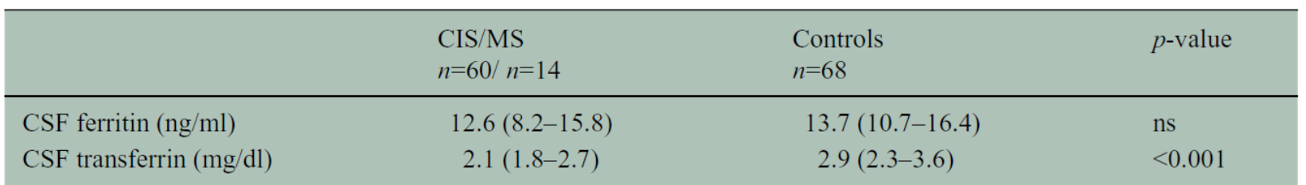
Aim of Research
We aimed to;
Evaluate whether the investigated parameters can be used as ancillary laboratory measurements in the diagnosis of the disease
Compare our results with the different results found in previous studies
End the confusion in the literature
Hashemi, Seyed. (2015) Iron, transferrin and ferritin concentrations in the cerebrospinal fluid of multiple sclerosis patients in comparison to controls.
Khalil M et al. (2014) Cerebrospinal fluid transferrin levels are reduced in patients with early multiple sclerosis.

Slide 9
Material and Method
Bezmialem Vakif University Department of Neurology (September 2020- May 2021)
MS patients were diagnosed according to the 2017 McDonald criteria and Relapsing-Remitting MS, Primer Progressive MS, and Seconder Progressive MS patients were included in the study.
31 newly diagnosed MS samples
45 control (headache and hydocephalicus) samples
Samples were taken into a 15 mL polypropylene test tube with the help of a Spinocan needle, centrifuged at 2000rpm for 10 minutes, and stored in the freezer at -80 degrees until the day they were to be studied.

Slide 10
Variables and Parameters:
Age
Gender (52 Female, 24 Male)
Ferritin, Transferrin
Myelin Basic Protein, Myelin Oligodendrocyte Glycoprotein
Copper, Zinc
Parameter levels were measured by using enzyme-linked immunosorbent assay (ELISA) kits.

Slide 11
Analysis
SPSS 28.0.0.0
Shapiro Wilk test
Independent t test
Mann-Whitney U test
Mean, Standart deviation
Significance threshold is p<0.05

Slide 12
Results

Slide 13
Results
 |  | Age | Ferritin | MBP | MOG | Transferrin | Copper | Zinc
MS | Median | 35,00 | 65,3600 | 2069,00 | 5,07300 | 6,98900 | 0,300 | 4,50
 | Minimum | 19 | 46,04 | 1233 | 2,543 | 1,787 | 0,0 | 0
 | Maximum | 57 | 114,00 | 32290 | 21,840 | 96,550 | 4,2 | 41
Control | Median | 43,00 | 70,6900 | 1959,00 | 5,20600 | 8,81400 | 0,400 | 6,50
 | Minimum | 20 | 43,67 | 1081 | 3,017 | 2,896 | 0,0 | 0
 | Maximum | 73 | 134,00 | 14846 | 26,470 | 94,390 | 1,3 | 56
Total | Median | 41,00 | 67,5800 | 2002,00 | 5,18150 | 7,67800 | 0,400 | 5,50
 | Minimum | 19 | 43,67 | 1081 | 2,543 | 1,787 | 0,0 | 0
 | Maximum | 73 | 134,00 | 32290 | 26,470 | 96,550 | 4,2 | 56
 | Ferritin | MBP | MOG | Transferrin | Copper | Zinc
p-value | 0,265 | 0,649 | 0,529 | 0,176 | 0,290 | 0,126

Slide 16
Age Correlations

Slide 17
Discussion
In the study of Steven M. LeVine et al(9)., ferritin levels were found to be significantly higher in the cerebrospinal fluid of chronic progressive active MS patients than in normal individuals. There was no serious increase in transferrin values.
In the study of Khalil et al.(8), a statistically significant decrease was observed in transferrin levels in MS patients, and no significant change was found in ferritin levels.
In the study of Seyed Hashemi et al.(7), CSF ferritin and transferrin levels of MS patients were found to be lower than normal individuals, but no statistically significant difference was found.
Our study showed the similar results for ferritin and transferrin levels

Slide 18
Warren KG et al. (10) showed that Myelin Basic Protein level is an objective marker of active demyelination and that high Myelin Basic Protein levels in many MS patients.
No statistically significant change was found in our study.
In the study of T.M. Melø et al (11), copper levels of MS patients were found to be significantly higher than the control group, but there was no significant difference between zinc levels.
No statistically significant change was found in our study for copper and zinc levels

Slide 19
Conclusion
Our study did not indicate a significant difference between MS patients and the control group in measured parameters. Due to the different results from previous studies and our project, more studies are needed to reach an overall conclusion.
It is important to research the disease, its pathogenesis and to find clinical auxiliary test methods that can be used in the diagnosis, follow-up, and treatment of MS.

Slide 20
https://stiwell.medel.com/neurology/multiple-sclerosis
Häggström, Mikael (2014). "Medical gallery of Mikael Häggström 2014".
Celik, Yahya, Ozlem Birgili, Asli Kiyat, Baburhan Guldiken, Hulya Ozkan, Hakan Yilmaz, Sebahattin Saip, et al. “Prevalence Of Multiple Sclerosis In The Metropolitan Area Of Edirne City, Turkey.” Medical Journal of Trakya University, 2010. https://doi.org/10.5174/tutfd.2010.04089.0.
The Multiple Sclerosis International Federation, Atlas of MS, 3rd Edition (September 2020).
Thompson, Alan J, Brenda L Banwell, Frederik Barkhof, William M Carroll, Timothy Coetzee, Giancarlo Comi, Jorge Correale, et al. “Diagnosis of Multiple Sclerosis: 2017 Revisions of the McDonald Criteria.” The Lancet Neurology 17, no. 2 (2018): 162–73. https://doi.org/10.1016/s1474-4422(17)30470-2.
Bradshaw, Michael & Houtchens, Maria. (2018). Neurology Board Review: Multiple Sclerosis. https://www.neurologyreviews-digital.com/neurologyreviews/ms_board_review_supp_0618/MobilePagedReplica.action?pm=1&folio=S1#pg1
Hashemi, Seyed. (2015). Iron, transferrin and ferritin concentrations in the cerebrospinal fluid of multiple sclerosis patients in comparison to controls. Der Pharma Chemica. 7. 221-224.
Khalil M, Riedlbauer B, Langkammer C, Enzinger C, Ropele S, Stojakovic T, et al. Cerebrospinal fluid transferrin levels are reduced in patients with early multiple sclerosis. Multiple sclerosis (Houndmills, Basingstoke, England). U.S. National Library of Medicine; 2014. Available from: https://www.ncbi.nlm.nih.gov/pubmed/24777275
LeVine SM, Lynch SG, Ou CN, Wulser MJ, Tam E, Boo N. Ferritin, transferrin and iron concentrations in the cerebrospinal fluid of multiple sclerosis patients. Brain research. U.S. National Library of Medicine; 1999. Available from: https://www.ncbi.nlm.nih.gov/pubmed/10064838
Warren KG, Catz I, McPherson TA. CSF myelin basic protein levels in acute optic neuritis and multiple sclerosis. The Canadian journal of neurological sciences. Le journal canadien des sciences neurologiques. U.S. National Library of Medicine; 1983. Available from: https://www.ncbi.nlm.nih.gov/pubmed/6197151
Melø, T.M., Larsen, C., White, L.R. et al. Manganese, copper, and zinc in cerebrospinal fluid from patients with multiple sclerosis. Biol Trace Elem Res 93, 1–8 (2003). https://doi.org/10.1385/BTER:93:1-3:1

